Slide 1
Learning from both good web design and bad web design
Good Web Design
http://www.youtube.com/watch?v=si4qm8dlYNc&feature=related
Bad Web Design
http://www.youtube.com/watch?v=wguO93zZd-U&feature=related

Slide 2
IT 325 Web site and Web Page Design
Lecture 2: HTML/XHTML Basics

Slide 3
The Birth of HTML
Created by Tim Berners-Lee at CERN
Open standard developed under supervision of the World Wide Web Consortium (www.w3.org)
  Works to ensure the full potential of the Web for shared, integrated functionality is realized

Slide 4
What is HTML?
Originally, people created Web pages using Hypertext Markup Language
Hypertext Markup Language (HTML) is a simple language used to create the Web pages that appear on the World Wide Web
The purpose of a web browser (like Internet Explorer or Firefox) is to read HTML documents and display them as web pages. The browser does not display the HTML tags, but uses the tags to interpret the content of the page.

Slide 5
What is HTML?
File extension: .htm, .html
HTML –are the instructions that tell a browser how to lay out the information (text, images, etc) in the browser window
It is made up of tags – an opening tag <html> and a closing tag </html> with the content that the tag is applied to, in between them. You use the tags to ‘mark up’ the text in between.
  For example – to apply boldface to a section of text, the html will look like <b> This text will be bold.</b>

Slide 6
HTML Tags
HTML tags are used to mark-up HTML elements
HTML tags are surrounded by the two characters < and >
The surrounding characters are called angle brackets
HTML tags normally come in pairs like <b> and </b>
The first tag in a pair is the start tag, the second tag is the end tag
The text between the start and end tags is the element content
HTML tags are not case sensitive, <b> means the same as <B>

Slide 7
How is a HTML File Looks Like
<html>
<head>
<title>Title of page</title>
</head>
<body>
This is my first homepage.
<b>This text is bold</b>
</body>
</html>

Slide 8
HTML
All HTML documents begin with <html> and end with </html>
Two other important HTML tags are the <head> tag and the <body> tag
The <head> tag contains information that is used by the Web browser, and you place it at the start of an HTML document, after the opening <html> tag
Following the document head is the <body> tag, which contains the document body
<html>
<head>
<title>Title of page</title>
</head>
<body>
This is my first homepage.
<b>This text is bold</b>
</body>
</html>

Slide 9
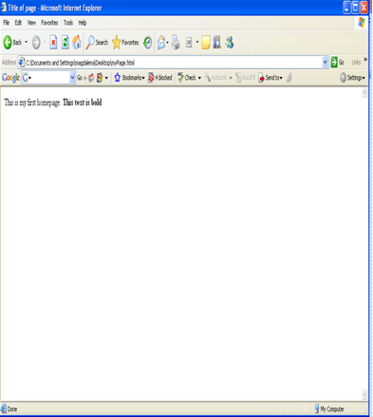
HTML parsing or rendering
A Web browser’s process of assembling and formatting an HTML document is called parsing or rendering

Slide 10
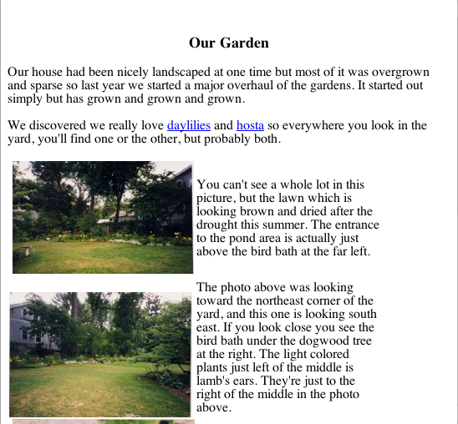
A simple page
All text
Direct links
Few graphics

Slide 11
Basic HTML tools
Plain text editor like NotePad – to write HTML documents
Web browser – to test and view the created web page
HTML reference book – to serve as guide for HTML tags

Slide 12
Why code HTML by hand?
Many people prefer to use HTML editors. So why do we write HTML code by hand?
It's not very hard, and gives a good understanding of how things work
You can often have more control over how things look if you code by hand.
Back-end server-side programming requires good knowledge of HTML coding, as does other advanced Web work.
HTML is the language of the Web. If you want to be a true web design superstar, you MUST know HTML.

Slide 13
Valid HTML
"Valid" means that the HTML tags and elements are used properly, in conformance with a particular version of the HTML standard.
HTML standards are developed and ratified by the World Wide Web Consortium or W3C, with input from industry groups, users and researchers.
Many HTML editors produce non-valid code

Slide 14
Valid HTML
The fact is that non-valid code often appears correctly in a Web browser, and therefore can sometimes be overlooked.
The benefit of valid HTML is that it is much more likely to work properly in ALL Web browsers, in different versions.
The other benefit is that valid HTML will stay valid, therefore working in future browsers. Otherwise, non-valid code might look OK in today's browser, but break in a future version

Slide 15
Basic HTML Syntax
For example: <b>, <title>, <p> etc.
Tag usually goes with pair: an open tag (<b>) and an end tag (</b>)
HTML Tags are NOT case sensitive: <b> and <B> have the same effect
But you should always use lowercase for tags and attributes.
Effect | Code | Code Used | What It Does
Bold | b | <b>Bold</b> | Bold
Italic | i | <i>Italic</i> | Italic
Notes:
HTML documents contain content that is to be displayed and tags that define the structure of the document (and in a few cases to specify formatting instructions). These tags are used by a browser to decide how to display the content. HTML documents are simple text files that can be created with any text editor, the tags are just special sequences that provide information to the browser on how to display them. HTML tags are always bracketed within a less-than (<) and greater-than (>) character. Every tag has a name that indicates to the browser some information about document structure, and some tags can have attributes that provide additional information to the browser.

Slide 16
Basic HTML Syntax
You use various parameters, called attributes, to configure many HTML tags
You place an attribute before the closing bracket of the starting tag, and separate it from the tag name or other attributes with a space
Example:
<img src="abc.jpg" width="104" height="142" />
Attribute values should always be enclosed in quotes.
Double style quotes are the most common, but single style quotes are also allowed.

Slide 17
Text In Paragraphs
Web Pages only format text when you tell them to!
If you need to indicate paragraphs, Place text in
<p> …. </p>
Don't Forget the End Tag
<html>
<body>
<p>This is a paragraph.</p>
<p>This is a paragraph.</p>
<p>This is a paragraph.</p>
<p>Paragraph elements are defined by the p tag.</p>
</body>
</html>

Slide 18
HTML Line Breaks
Use the <br /> tag if you want a line break (a new line) without starting a new paragraph:
Example
This is <br />a sentence<br />with line breaks.

Slide 19
Headings
Headings are defined with the <h1> to <h6> tags. <h1> defines the largest heading. <h6> defines the smallest heading.
<h1>This is a heading 1</h1>
<h2>This is a heading 2</h2>
HTML automatically adds an extra blank line before and after a heading.
Aligning Text
  <h1 align="center">This is heading 1</h1> (or right left)

Slide 20
Headings
Use HTML headings for headings only. Don't use headings to make text BIG or bold.
6 heading commands.
<H1>This is Heading 1</H1>
<H2>This is Heading 2</H2>
<H3>This is Heading 3</H3>
<H4>This is Heading 4</H4>
<H5>This is Heading 5</H5>
<H6>This is Heading 6</H6>
Notes:
A number of tags are defined to be used to indicate section headings within a document. Typically a document contains a number of sections (chapters), and within each section are subsections, and within subsections are sub-subsections, and so on. The heading tags are <h1>, <h2>, <h3>, ... <h6>, with H1 being the highest level heading (usually rendered the largest) and H6 the lowest level heading.

Slide 21
Special Characters
There are many non-keyboard non-standard characters you may want to use: e.g. the euro symbol.
  Called character entities
  A character entity has three parts: an ampersand (&), an entity name or a # and an entity number, and finally a semicolon (;).
  e.g: &euro; &#34; &nbsp;
  See http://www.utexas.edu/learn/html/spchar.html for examples
  Note not always available with all browsers.

Slide 22
Commonly Used Character Entities
Result | Description | Entity Name
 | Non-breaking space | &nbsp;
< | Less than | &lt;
> | Greater than | &gt;
& | Ampersand | &amp;
“ | Quotation mark | &quot;
© | Copyright | &copy;
Notes:
Some characters have a special meaning in HTML, like the less than sign (<) that defines the start of an HTML tag. If we want the browser to actually display these characters we must insert character entities in the HTML source.

Slide 23
Your First Web Page – part 1
Open Notepad
Click on File -> Save as…
In the File name pull-down box, type in mypage.html
Click on Save
Create your basic document layout – add the following to your document:
  <HTML></HTML> - Creates an HTML document
  <HEAD></HEAD> - Where you create the title of the page and other universal document information
  <BODY></BODY> - The visible portion of the page
Giving your page a name
  <TITLE>My very first HTML page</TITLE>
Once you finished the content, click on File -> Save

Slide 24
Your First Web Page - example
<html>
<head>
<title> My very first HTML page </title>
</head>
<body>
content goes here
</body>
</html>
Notes:
Every HTML document should start with the tag <html> and end with the tag </html>, this tells the browser that this is an HTML document. Each HTML document includes a head and a body. The head includes information about the document (possibly the title, author, date of creation, software used to create the document) and the body contains the content of the document. There are tags used to identify these sections:
<head> </head> these tags surround the head of the document and come first (before the body tags).
<body> </body> these tags surround the content of the document.
The head and body tags are actually required by the latest version of HTML. Within the title tags the document should contain a document title - this title is typically shown in the title bar of the browser window. Document titles should convey something useful about the content of the document.

Slide 25
Your First Web Page – part 2
Giving your page some content
  In-between the <body></body> tags add the following lines of text:
    Your name
    Your school
    Interesting fact about yourself
    Interesting/humorous fact about your school
  Save your page to your desktop – with a .htm or .html extension
  Open browser to view your page

Slide 26
Your First Web Page – part 3
Add a link
  Hyperlink tag
  <a href="http://www.odu.edu/">Old Dominion University</a>
  Save and view your page, click on link then click on the browser’s “Back” button to return to your page.
Link to your e-mail address
  Hyperlink tag with “mailto” reference
  <a href="mailto:whe@odu.edu">My e-mail</A>
Save and view your page

Slide 27
Your First Web Page – part 4
Add some line breaks / carriage returns at the end of each line
  Line break tag: <br />
Save your page and view it again
Add a header line for your content
  Header tag <h1> (largest), <h2>, <h3>, <h4>, <h5>, <h6> (smallest)
  <h3>My Information</h3>
Save your page and view it again
Make your name bolded text
  Bold tag <b>Your Name</b>
Make the name of your school italicized text
  Italicize tag <i>Job Title</i>
Save your page and view it again

Slide 28
Background
Bgcolor
Specifies a background-color for a HTML page.
<body bgcolor="#000000"> <body bgcolor="rgb(0,0,0)"> <body bgcolor="black">
Background
Specifies a background-image for a HTML page
<body background="clouds.gif">
<body background="http://www.w3schools.com/clouds.gif">

Slide 29
Hexadecimal Color Codes
link =“#000000” – The six numbers following the # sign denotes the hexadecimal code for a particular color (in this case, black). If you were to put this piece of code in the opening body tag of your html document, all your links (by default) would be black.
You don’t need to memorize these numbers, but they are handy to know.
#000000 –Blackblack
#FFFFFF – white
#0000FF – blue (default link color)
#FF0000 – red (default active link color)
#80080 – purple (default visited link color)

Slide 30
Your First Web Page – part 5
Page cosmetics
Changing your background color
  Using the bgcolor attribute in the <BODY> tag
  <body bgcolor=“blue”>
  Choose a background color (white is default)
  Possible bgcolor values
    Color names (eg: blue, red, purple)
      Simple colors
    Hex values (#6633FF, #CC3300, #993399)
      More complex colors
      See reference for more hex colors
Save and view your page

Slide 31
HTML Organization
Spacing
  Spacing organizes your work!
  Spacing makes your files easy to read!
  Spacing makes no functional difference to your web browser
<hr /> tag is used to create an horizontal rule (line).
Comments
  Comments are notes in your HTML file
  Comments make no functional difference to your web browser
  “<!--” begins a comment, and “ -->” ends it

Slide 32
Comment Examples
<!-- This is a comment -->
<!--
This paragraph,
is also a
comment...
-->

Slide 33
Basic HTML Tags
<html> Defines an HTML document </html>
<body> Defines the document's body</body>
<h1> to <h6> Defines header 1 to header 6
<p> Defines a paragraph </p>
<br /> Inserts a single line break
<hr /> Defines a horizontal rule
<!--> Defines a comment -->

Slide 34
More about Links
<a href="http://www.odu.edu/">Visit ODU</a>
Target attribute: open the page in a new browser window
<a href="http://www.odu.edu/ " target="_blank">Visit ODU</a>

Slide 35
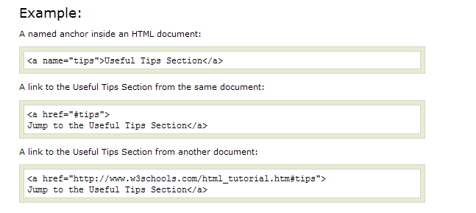
More about Links
Name attribute: defines a named anchor inside a HTML document.

Slide 36
Lists
Unordered list
  Code:
  <ul>
  <li>Coffee</li> <li>Milk</li>
  </ul>
  Output:
    Coffee
    Milk
Ordered list
  Code:
  <ol>
  <li>Coffee</li> <li>Milk</li>
  </ol>
  Output:
    Coffee
    Milk
Notes:
HTML supports ordered (numbered) and unordered lists. Each list can include a number of list items, the browser renders these list items in a way that (hopefully) appears as a list.
Unordered lists are contained within the tags <ul> and </ul>. Ordered lists are contained within the <ol> and </ol> tags. In both cases each individual list item is contained within the <li> and </li> tags.

Slide 37
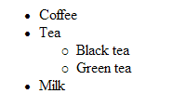
A Nested List
<ul>
<li>Coffee</li>
<li>Tea
<ul>
<li>Black tea</li>
<li>Green tea</li>
</ul>
</li>
<li>Milk</li>
</ul>

Slide 38
Images
Two main types of Web graphic files
  GIF (Graphics Interchange Format)
    Great for logos, charts, buttons
  JPG (Joint Photographic Experts Group)
    Great for photographs
<img src="URL of image file">
  Place all images in the same directory/folder where you web pages are

Slide 39
Images
Important points about graphics
  Keep graphic files size small: Most users are impatient when it comes to pages loading.
  Add ALTernative text to identify graphics in non-graphic browsers.
<img src="images/seeds.jpg" alt="picture of seeds" height="100" width="100">
  Resize the image in a graphic editor rather than sizing the graphic in HTML

Slide 40
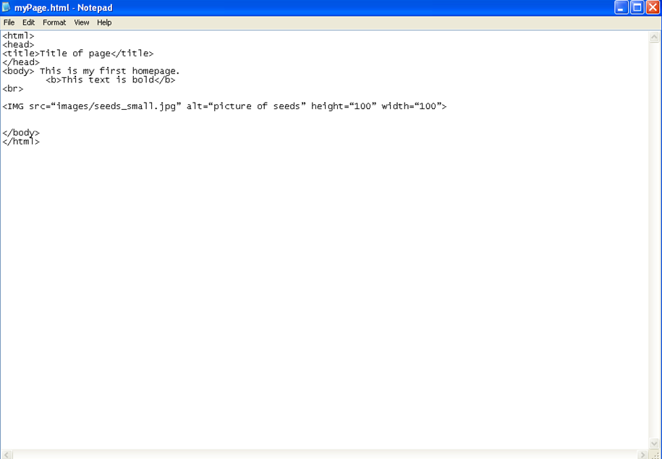

Slide 41
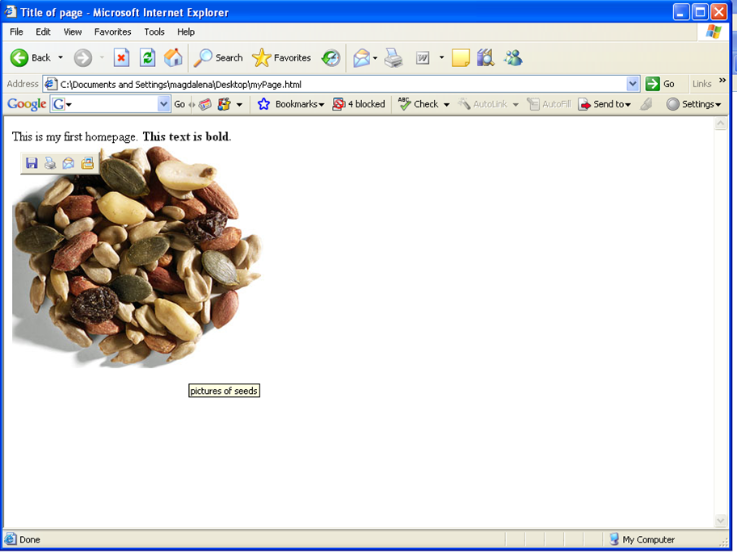

Slide 42
Tables
<table>...</table>
<tr>...</tr> for each row
<td>...</td> for each element in a row
<th>…</th> for header row

Slide 43
Tables and the Border Attribute
If you do not specify a border attribute, the table will be displayed without any borders.
To display a table with borders, you will have to use the border attribute

Slide 44
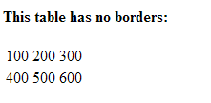
Table with no borders:
<table>
<tr>
<td>100</td>
<td>200</td>
<td>300</td>
</tr>
<tr>
<td>400</td>
<td>500</td>
<td>600</td>
</tr>
</table>

Slide 45
Table with borders
<table border="1">
<tr>
<th>Heading</th>
<th>Another Heading</th>
</tr>
<tr>
<td>row 1, cell 1</td>
<td>row 1, cell 2</td>
</tr>
<tr>
<td>row 2, cell 1</td>
<td></td>
</tr>
</table>
Heading | Another Heading
Row 1, cell 1 | Row 1, cell 2
Row 2, cell 1
Notes:
HTML supports the display of tabular data using tables. Tables are also used to manage document layout (probably more often than to display tabular data). The HTML table model includes three basic elements - the table ( <table> and </table> tags), table row ( <tr> and </tr> tags) and a table cell (using either <th>,</th> or <td>,</td> tags).

Slide 46
How to View HTML Source
To find out, click the VIEW option in your browser's toolbar and select SOURCE or PAGE SOURCE. This will open a window that shows you the HTML code of the page.

Slide 47
To publish a website on the internet – if you want it to be seen by others
Need to have a web space to publish your sites
To transfer your files to a web space, you need a FTP-program (file transfer protocol)
You often need hostname, user Id, password
Call the first page (start page) index.html. The web server is then automatically sending this site when someone is asking for the url-address.

Slide 48
How to retrieve a web page
Ask for certain address
client
Web server
The web server finds the document and sends it back to the client computer.
Notes:
A client ask the webserver for a certain site, which the server finds out and send back to the client.

Slide 49
Additional Learning Resource
A great HTML tutorial with many examples can be found at:
http://www.w3schools.com/html/

Slide 50
What Is XHTML?
XHTML stands for EXtensible HyperText Markup Language
XHTML is almost identical to HTML 4.01
XHTML is a stricter and cleaner version of HTML
XHTML is a W3C Recommendation
All browsers support XHTML.

Slide 51
The Evolution of XHTML
The Web is expanding to other media, called user agents, which are devices that are capable of retrieving and processing HTML and XHTML documents

Slide 52

The Evolution of XHTML
A user agent can be a traditional Web browser or a device such as a mobile phone or PDA, or even an application that simply collects and processes data instead of displaying it
HTML is not suitable for user agents other than Web browsers

Slide 53
XHTML
XHTML is a version of HTML modified to conform to the XML standard
Designed to separate content from presentation
  Content in XHTML
  Presentation controlled by Cascading Style Sheets (CSS)
XML Compatible – Other XML based languages can be embedded in XHTML documents
Like a programming language
  Specific syntax to use
  Validators help you get it right

Slide 54
XHTML Differences
Case is significant. XHTML elements must be in lowercase
All elements must have begin tags and end tags <p>Hello</p>
Empty elements contain their own end tag
<br /> <img src="picture.gif" id="pic1" />
Attribute values must be enclosed in quotation marks
More specfics available at http://www.w3.org/TR/xhtml1/#diffs

Slide 55
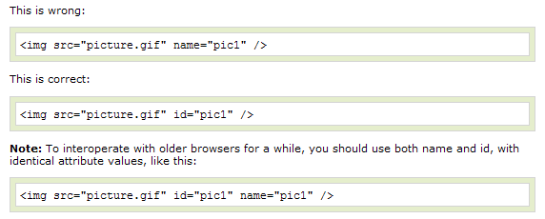
The id Attribute Replaces The name Attribute
In XHTML the name attribute is deprecated. Use id instead.

Slide 56
A Simple XHTML File
<!DOCTYPE html PUBLIC "-//W3C//DTD XHTML 1.0 Transitional//EN" "http://www.w3.org/TR/xhtml1/DTD/xhtml1-transitional.dtd">
<html>
<head>
<title>
My Home Page
</title>
</head>
<body>
<h1>My Home Page </h1>
<p>
Welcome to my home page
</p>
</body>
</html>

Slide 57
The DOCTYPE Statement
Declares the specific version of HTML or XHTML being used on the page
Used by the browser to decide how to process the page
Three types
  Transitional - Forgiving
  Strict – Requires adherence to standards
  Frameset – Use if page has frames
Always first in file

Slide 58
Things to Do
  Complete the assignment 2
  Read Chapters 1- 6 during the next 7 days

